Slide 1
Business Analytics
Dr. Mehmet Yasin Ulukuş
Lecture 1
Introduction to Business Analytics – LP Modeling

Slide 2
Course Overview
Instructors:
  Mehmet Yasin Ulukus, PhD
    Email: ulukus@itu.edu.tr
Lecture hours: Tuesday 19:00-22:00

Slide 3
Course Overview
Tentative Outline
  Prescriptive Analytics (First 6 weeks)
    Linear Programming, Integer Programming, Non-Linear Programming, Decision Analysis
  Predictive Analytics (Last 5 weeks)
    Regression, Classification, Forecasting
Grading
  2 in class exams (50% each)
Book: Business Analytics by James Evans 2nd Edition
Lecture Notes not always in parallel with the book

Slide 4
Course Objective
The course aims to equip students with basic operations research concepts, methods, tools and software.
  Descriptive
  Predictive
  Prescriptive
Python and Excel Solver will be highlighted and used.

Slide 5
Business Analytics
Business analytics, or simply analytics, is the use of
  data,
  information technology,
  statistical analysis,
  quantitative methods,
  and mathematical or computer-based models to
To help managers gain improved insight about their business operations and make better, fact based decisions
Much of modern business analytics stems from the analysis and solution of complex decision problems using mathematical or computer-based models
IMPORTANT WARNING!
  Purely mathematical solutions are not always effective. Human motives and behaviors must be considered

Slide 6
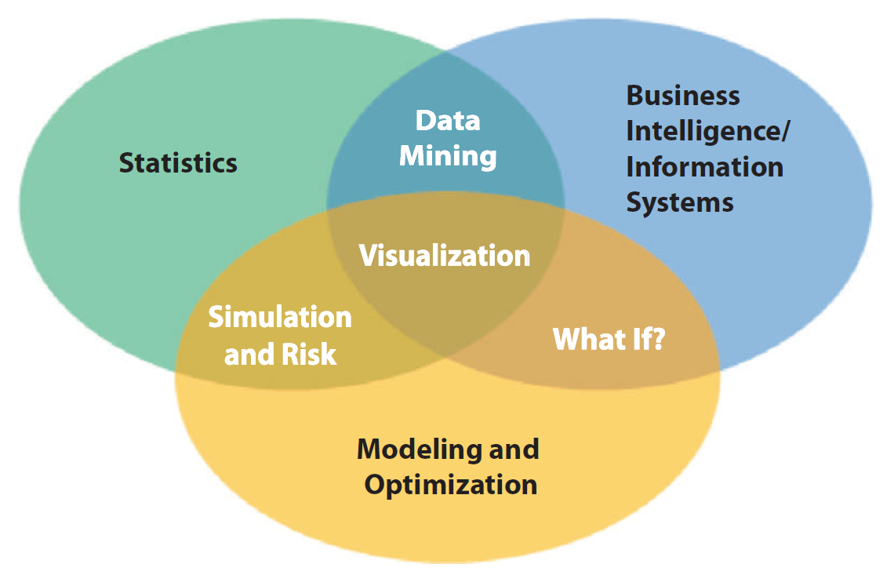
Visual Perspective of Business Analytics

Slide 7
Scope of Business Analytics
Descriptive analytics:
  Summarizes data into meaningful charts and reports
  Typical questions “How much did we sell in each region?” “What was our revenue and profit last quarter?” “Which factory has the lowest productivity?”
Predictive analytics:
  Seeks to predict the future by examining historical data, detecting patterns, and then extrapolating these relationships forward in time.
  Some examples: identify the most profitable customers or predict the chances that a loan applicant will default
Prescriptive analytics:
  To identify the best alternatives to minimize or maximize some objective
  Some examples: Determine the best pricing and advertising strategy to maximize revenue, the optimal amount of cash to store in ATMs, or the best mix of investments in a retirement portfolio to manage risk

Slide 8
Prescriptive Analytics
In summary
  Prescriptive Analytics (Operations Research) seeks the determination of the best (optimum) course of action in a decision problem under the restriction of limited resources
  It uses mathematical techniques to model and analyze decision problems
Some OR Techniques:
Linear programming
Integer linear programming
Nonlinear programming
Network models
Inventory Theory
Queueing Theory
Simulation
Decision analysis
Game Theory
Goal programming
Analytic hierarchy process
Forecasting
Markov-Process Models
Dynamic Programming

Slide 9
Components of a Decision Problem
Objective: The end result to achieve by taking a course of action
  Profit, Revenue, Cost, Quality of Service, Safety, Life years
Variables: Factors that are under direct control of the decision maker
  Determination of the correct variables is crucial
  Complex or simple mathematical relation between objective and variables
Parameters: Factors that are not under control
  Deterministic, random, static, dynamic
Notes:
Draw complicated graph

Slide 10
Mathematical Modeling
Model is an abstraction of a real situation or a system
Less complex than reality, but serves the purpose
Models show relations and interrelations between entities of a system
In mathematical modeling the relations are represented in mathematical form
Math models should be
  As simple and understandable possible
  Reasonable
  Adaptable
  Easy to control
  Solvable

Slide 11
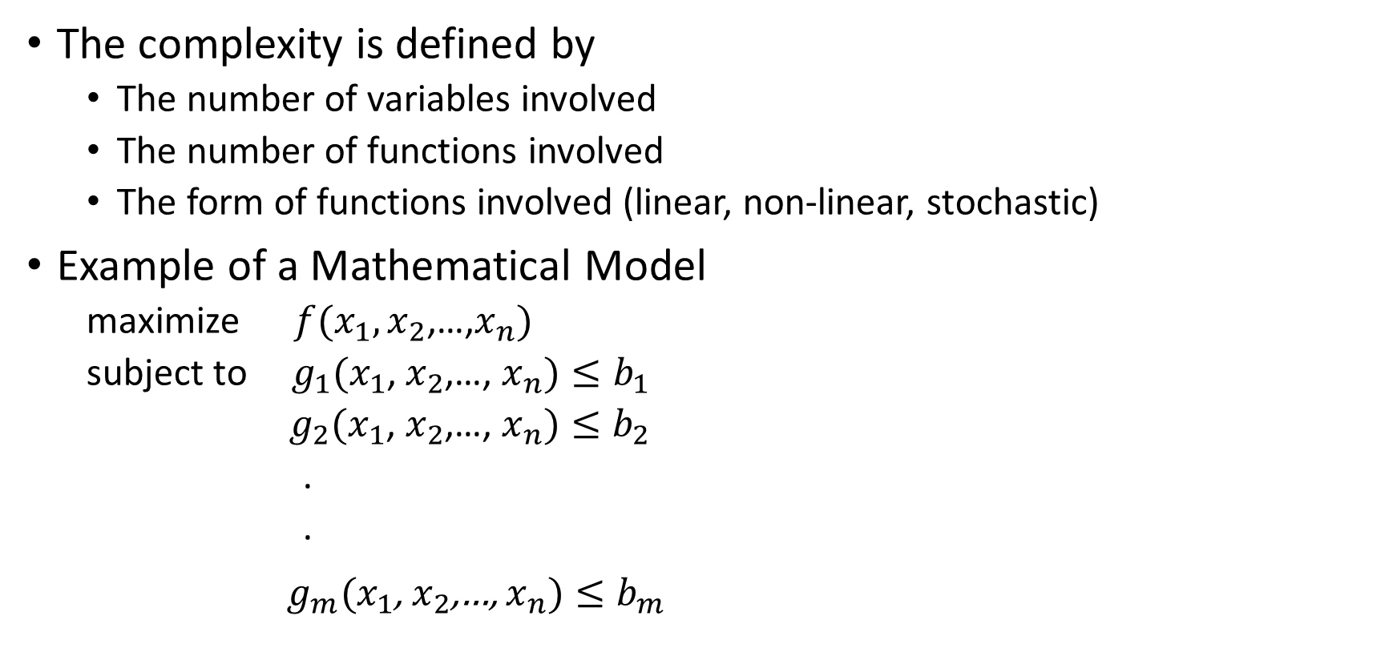
Mathematical Modeling
The complexity is defined by
  The number of variables involved
  The number of functions involved
  The form of functions involved (linear, non-linear, stochastic)
Example of a Mathematical Model
  maximize $f(x_{1},x_{2}$,…,$x_{n})$
  subject to ${ g}_{1}(x_{1}$, $x_{2}$,…, $x_{n})≤b_{1}$
  ${ g}_{2}(x_{1}$, $x_{2}$,…, $x_{n})≤b_{2}$
  .
  .
${ g}_{m}(x_{1}$, $x_{2}$,…, $x_{n})≤b_{m}$

Slide 12
Phases of an Analytics Study
Problem Identification
Development of Mathematical Model
Solution of the Model
Model Validation/ Sensitivity Analysis
Implementation

Slide 13
Linear Programming
LP is a mathematical modeling technique used for optimizing the use of limited resources.
Applications of LP can be found in military, industry, agriculture, transportation, economics, health systems, etc.
In 1947 George Dantzig developed an efficient method, the SIMPLEX Algorithm to solve LP problems.
LP involves heavy computations, hence in practice LP problems are solved with computer.
We will not be geting into mathematical details of solution techniques

Slide 14
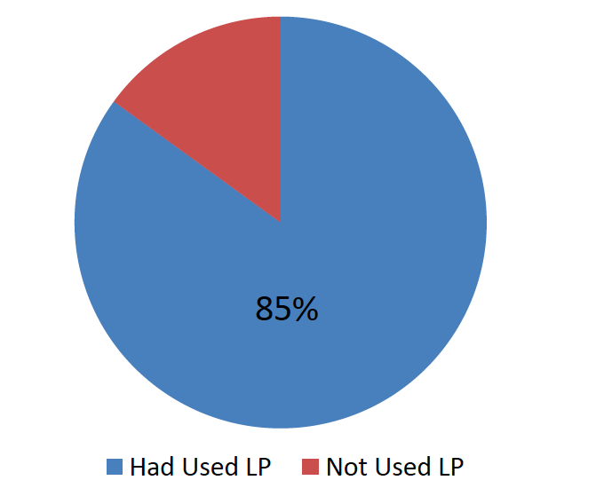
Linear Programming
Survey of Fortune 500 Firms

Slide 15
Linear Programming Steps
  Data collection (what you have already known)
  Decision variables (What you want to know and can adjust)
  Constraints (what you have to abide with)
    Restrictions on decision variables
    General Constraints
  Objective (What you want to achieve)
  We will show these components through examples

Slide 16
Example 1
Reddy Mikks produces both exterior and interior paints, which make profits of $5k and $4k per ton respectively (the selling price is $15k and $13k per ton). But these two products consume both raw materials 1 and 2, namely M1 and M2. Some data about consumption of raw materials are shown below,
Also we know that the maximum daily demand of interior paint is 2 tons, and the daily demand of interior paint production can not exceed that of exterior paint by more than 1 ton. What is best product mix?
 | Tons of raw material per ton of |  | Maximum daily availability (tons)
 | Exterior paint | Interior paint
M1 | 6 | 4 | 24
M2 | 1 | 2 | 6

Slide 17
Identifying Objective
What is the best product mix?
What is your goal/objective in this problem?
  Maximize your profit?
We need to define our objective.
Maximize the total profit for the company.

Slide 18
Decision Variables
After defining the objective/goal, we need to ask how to achieve that.
We need to find out what we can maneuver/control
What is the best product mix?
We can control the daily production amounts of exterior and interior paints.
We need to be quantitative:
  𝒙_{𝟏}: daily production of exterior paint
  𝒙_{𝟐}: daily production of interior paint
  Both of them are nonnegative and continuous variables

Slide 19
Be a “law abiding citizen”
The are rules or restrictions everywhere
A realistic model need to be realistic or “law abiding”
So what are restrictions/constraints?
  Raw material usage limits.
  Demand limits.
  Others?

Slide 20
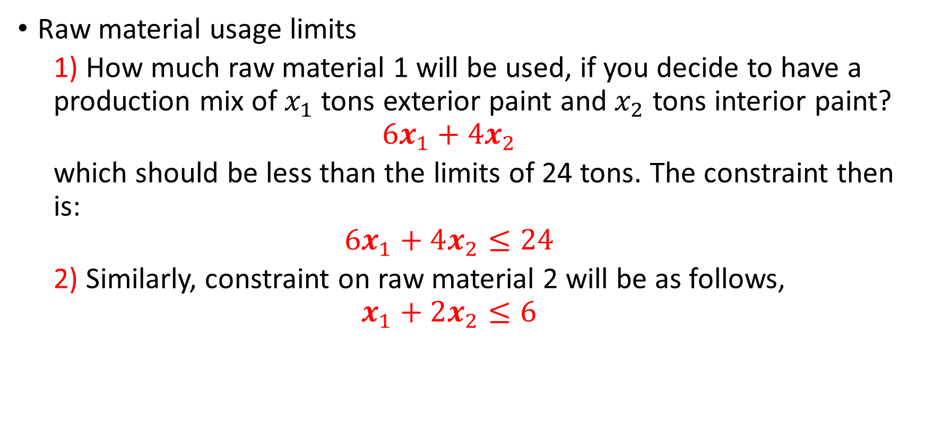
Constraints
Raw material usage limits
  1) How much raw material 1 will be used, if you decide to have a production mix of $x_{1}$ tons exterior paint and $x_{2}$ tons interior paint?
  $$6x_{1}+4x_{2}$$
  which should be less than the limits of 24 tons. The constraint then is:
  $$6x_{1}+4x_{2}≤24$$
  2) Similarly, constraint on raw material 2 will be as follows,
  $$x_{1}+2x_{2}≤6$$

Slide 21
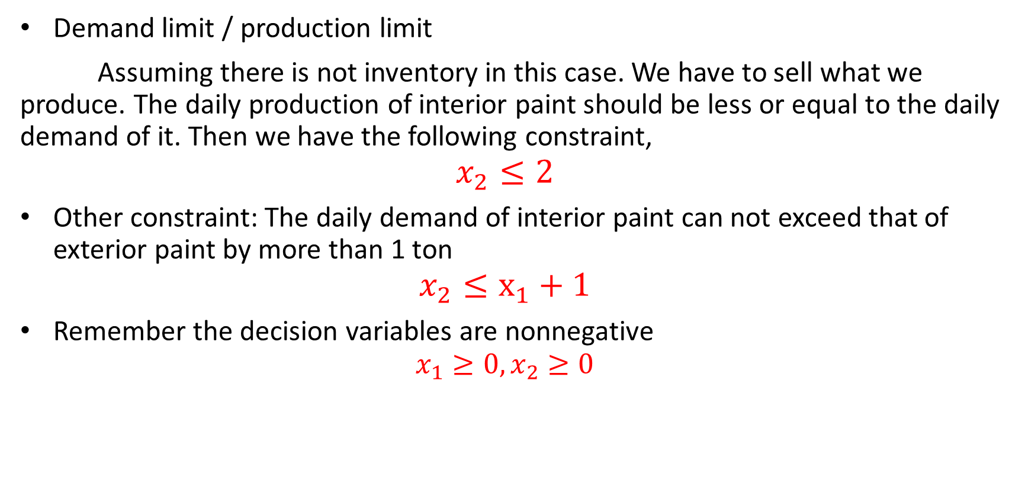
Constraints
Demand limit / production limit
Assuming there is not inventory in this case. We have to sell what we produce. The daily production of interior paint should be less or equal to the daily demand of it. Then we have the following constraint,
$$x_{2}≤2$$
Other constraint: The daily demand of interior paint can not exceed that of exterior paint by more than 1 ton
$$x_{2}≤x_{1}+1$$
Remember the decision variables are nonnegative
$$x_{1}≥0,x_{2}≥0$$

Slide 22
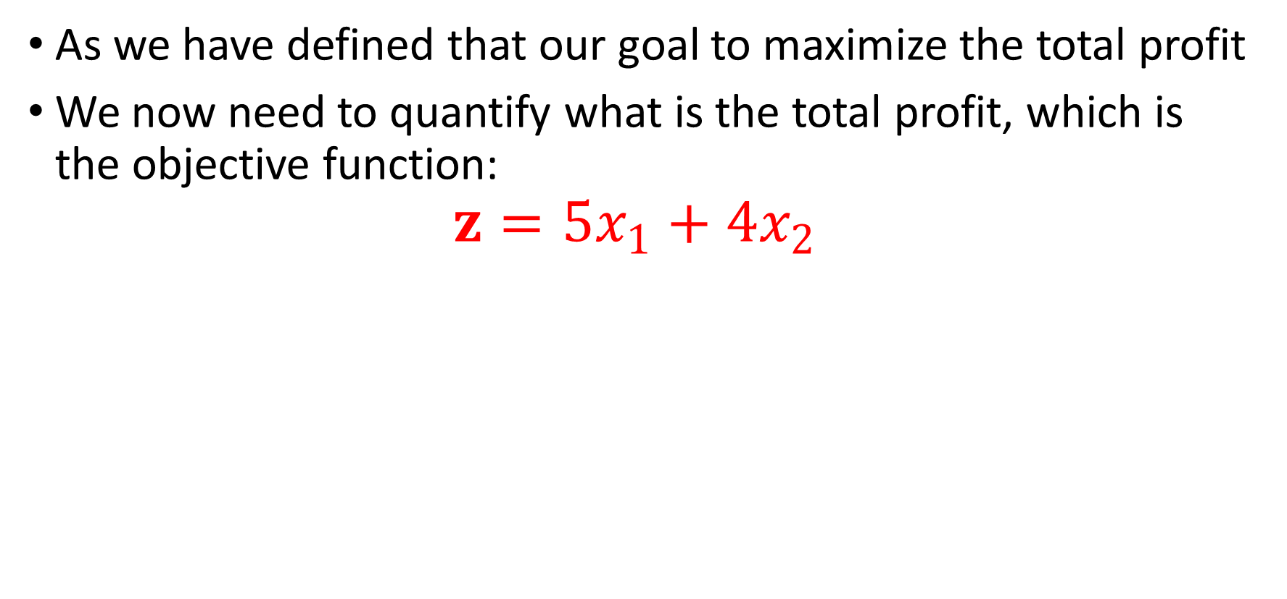
Objective Function
As we have defined that our goal to maximize the total profit
We now need to quantify what is the total profit, which is the objective function:
$$z=5x_{1}+4x_{2}$$

Slide 23
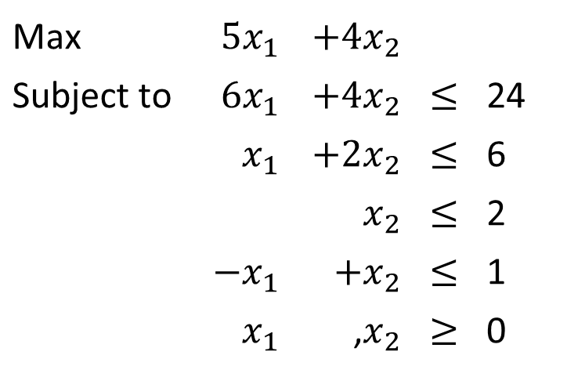
Linear Programming Model
The formulation is
Max | $$5x_{1}$$ | $$+4x_{2}$$
Subject to | $$6x_{1}$$ | $$+4x_{2}$$ | $$≤$$ | 24
 | $$x_{1}$$ | $$+2x_{2}$$ | $$≤$$ | 6
 |  | $$x_{2}$$ | $$≤$$ | 2
 | $$−x_{1}$$ | $$+x_{2}$$ | $$≤$$ | 1
 | $$x_{1}$$ | ,$x_{2}$ | $$≥$$ | 0

Slide 24
Example 2
A farmer has 100 acres of land, some or all of which he can use to raise only potatoes and/or wheat. The farmer has 160 man-days of labor available, and he has $11,000 capital. Furthermore, he knows that wheat brings in a revenue of $1200/acre and potato bring in a revenue of $400/acre. The input costs (seeding, cultivating etc.) are $200/acre for wheat and $100/acre for potatoes. The amount of labor required to raise crops is, 4 man-days/acre for wheat and 1 man-days/acre for potatoes.

Slide 25
Example 2
Following table summarizes the information
The farmer wishes to know how many acres of wheat and how many acres of potatoes he should plant to maximize his revenue.
 | Potato | Wheat | Capacity
Acreage | 1 | 1 | 100
Labor | 1 | 4 | 160
Capital | 100 | 200 | 11,000

Slide 26
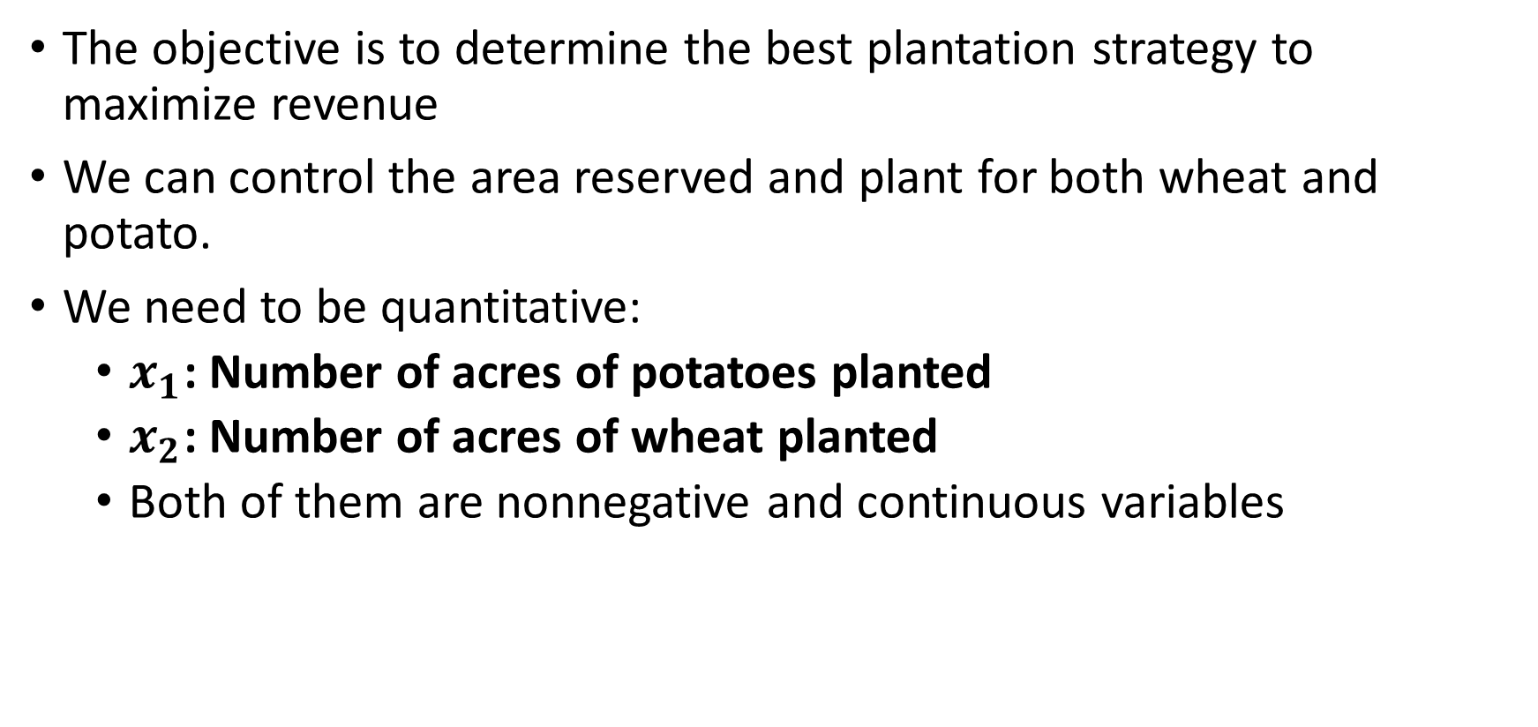
Decision Variables
The objective is to determine the best plantation strategy to maximize revenue
We can control the area reserved and plant for both wheat and potato.
We need to be quantitative:
  $x_{1}$: Number of acres of potatoes planted
  $x_{2}$: Number of acres of wheat planted
  Both of them are nonnegative and continuous variables

Slide 27
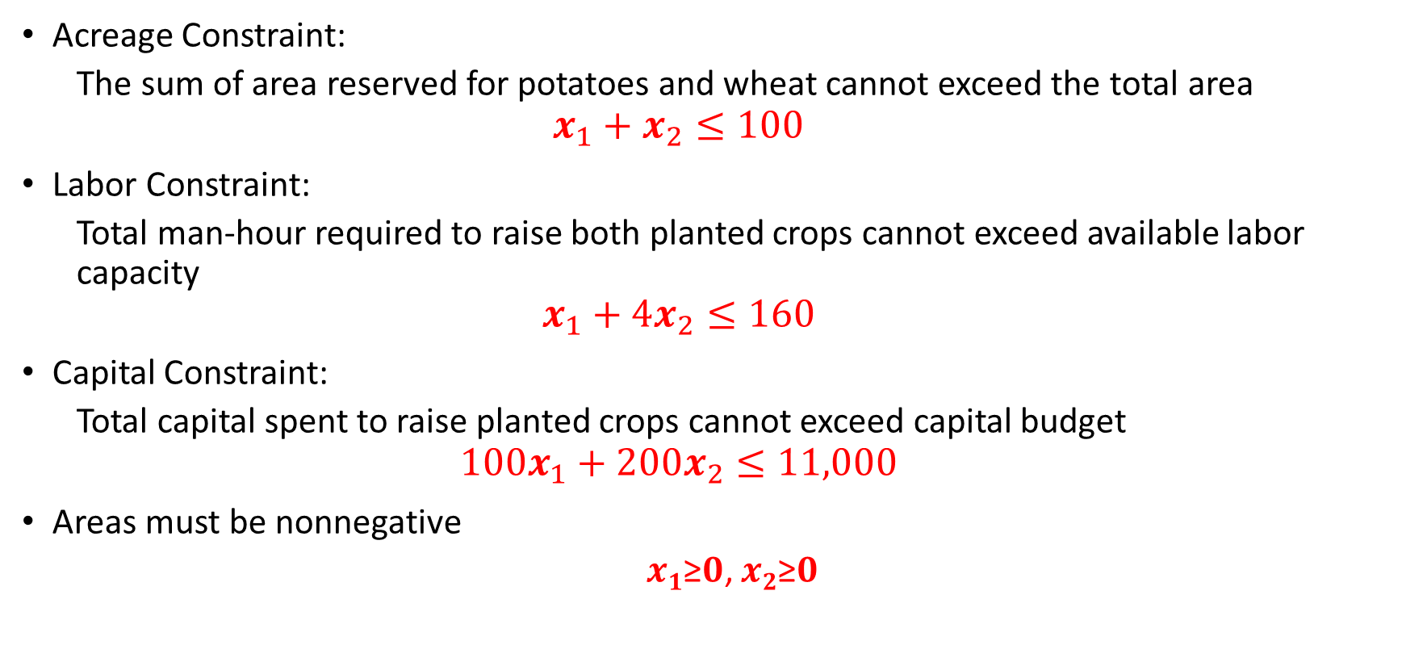
Constraints
Acreage Constraint:
  The sum of area reserved for potatoes and wheat cannot exceed the total area
  $$x_{1}+x_{2}≤100$$
Labor Constraint:
  Total man-hour required to raise both planted crops cannot exceed available labor capacity
  $$x_{1}+4x_{2}≤160$$
Capital Constraint:
  Total capital spent to raise planted crops cannot exceed capital budget
  $$100x_{1}+200x_{2}≤11,000$$
Areas must be nonnegative
  𝒙_{𝟏}≥𝟎, 𝒙_{𝟐}≥𝟎

Slide 28
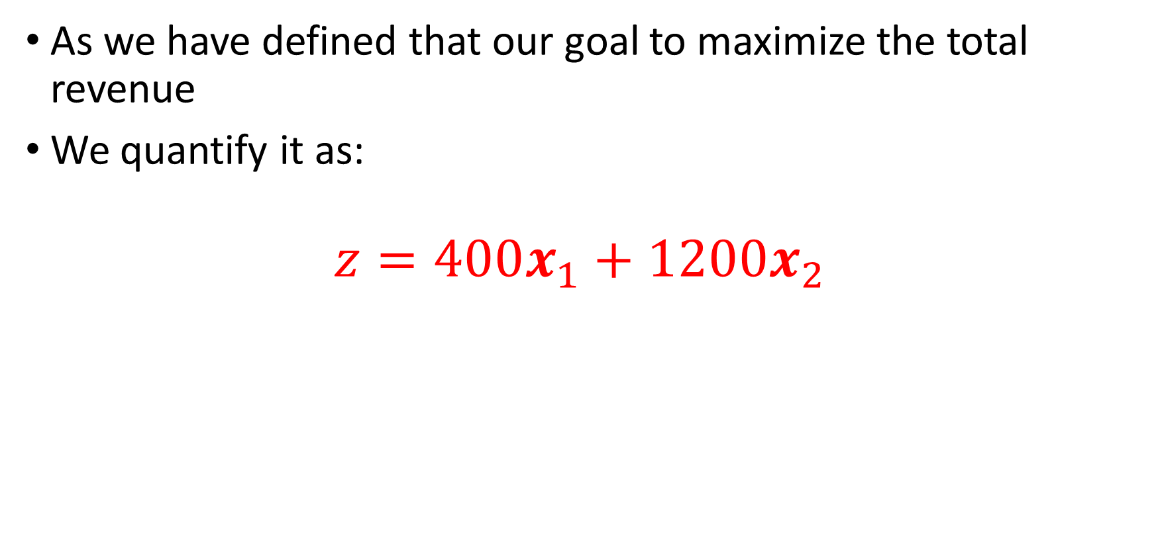
Objective Function
As we have defined that our goal to maximize the total revenue
We quantify it as:
$$z=400x_{1}+1200x_{2}$$

Slide 29
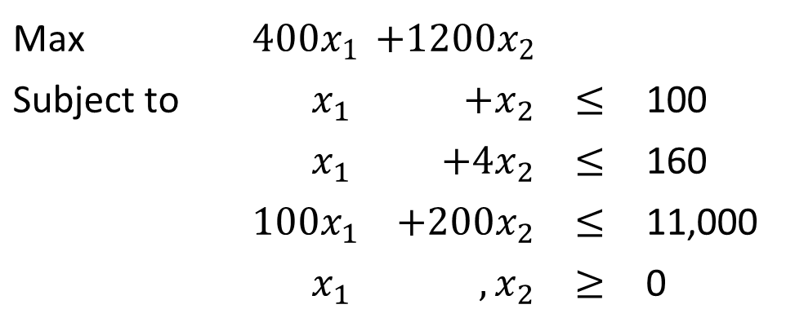
The Linear Programming Model
The formulation is
Max | $$400x_{1}$$ | $$+1200x_{2}$$
Subject to | $$x_{1}$$ | $$+x_{2}$$ | $$≤$$ | 100
 | $$x_{1}$$ | $$+4x_{2}$$ | $$≤$$ | 160
 | $$100x_{1}$$ | $$+200x_{2}$$ | $$≤$$ | 11,000
 | $$x_{1}$$ | $$,x_{2}$$ | $$≥$$ | 0

Slide 30
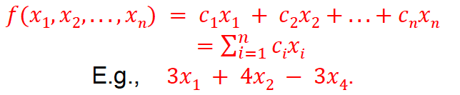
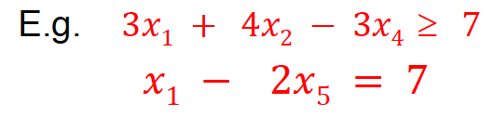
Linear Program General Formulation
A linear function is a function of the form:
A Mathematical program is a linear program (LP) if the objective is a linear function and the constraints are linear equalities or inequalities.
Typically, an LP has non-negativity constraints.

Slide 31
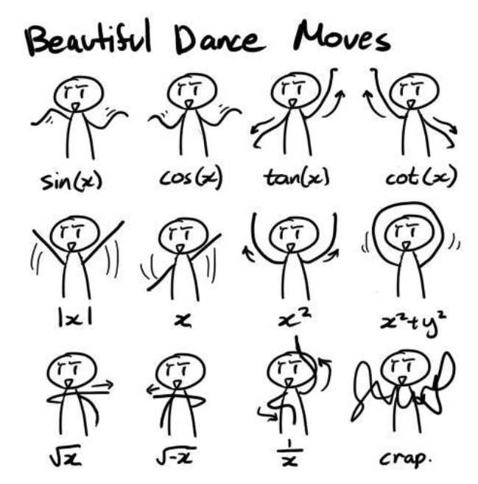
Linear Functions

Slide 32
Linear Functions
If x and y are decision variables, which of these are Linear Functions or equations?
x + y
3x + 5y ≤ 25
xy ≤ 25
x + y ≤ 25/(x+y)
(12x + 6y + 8z)/(x+y+z) > 10
a²x + 10 =(1/b)y

Slide 33
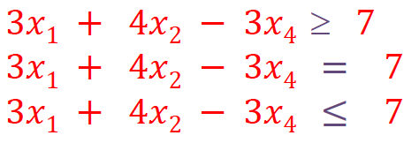
Linear Constraints
Linear constraints are linear functions that are restricted to be "less than or equal to", "equal to", or "greater than or equal to" a constant.

Slide 34
Linear Programming Assumptions
In fact, the model is called LINEAR if it satisfies two assumptions:
1. Proportionality
The contribution of each decision variable in both the objective function and the constraints is directly proportional to the value of the variable.
2. Additivity
The total contribution of all the variables in the objective function and in the constraints is the direct sum of individual contribution of each variable.
A similar argument holds for constraints.

Slide 35
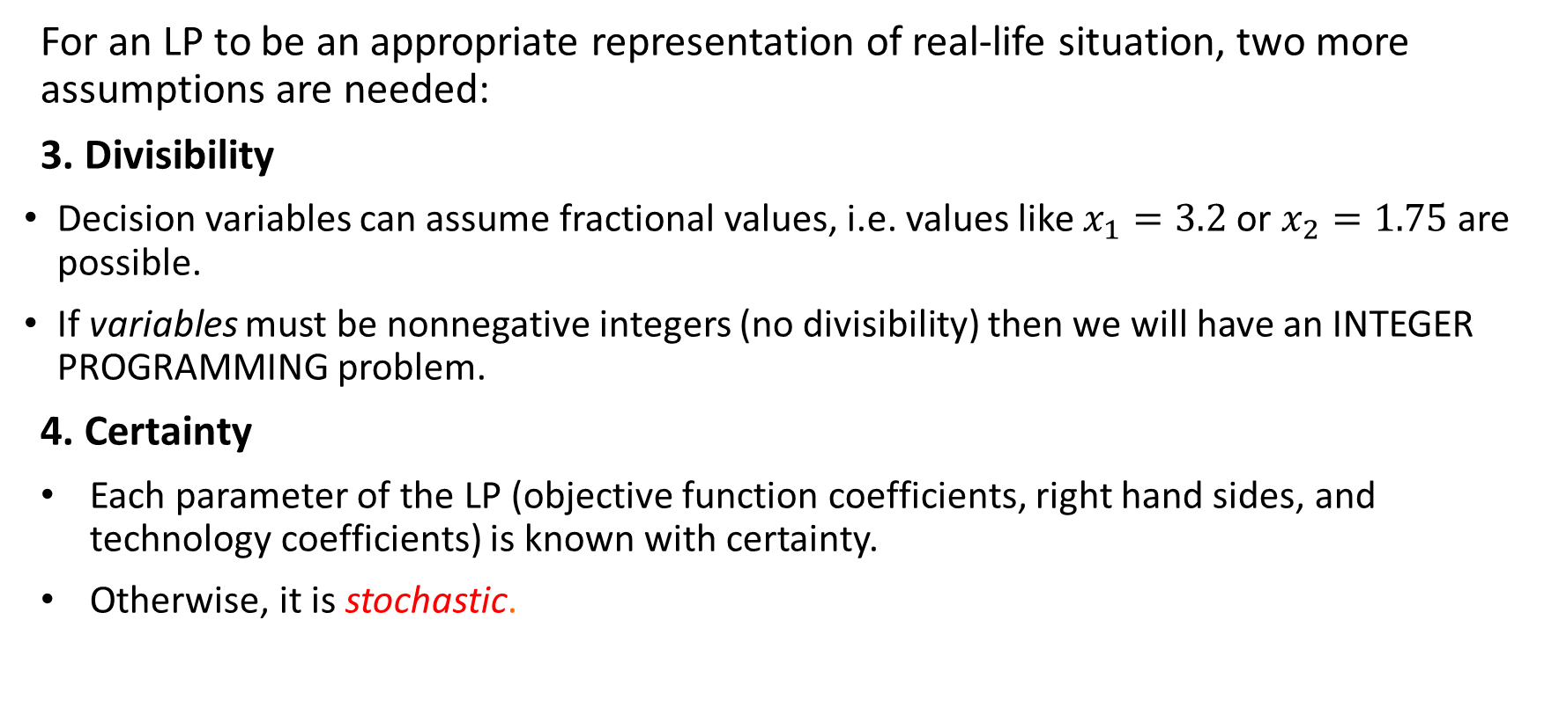
Linear Programming Assumptions
For an LP to be an appropriate representation of real-life situation, two more assumptions are needed:
3. Divisibility
Decision variables can assume fractional values, i.e. values like $x_{1}=3.2$ or $x_{2}=1.75$ are possible.
If variables must be nonnegative integers (no divisibility) then we will have an INTEGER PROGRAMMING problem.
4. Certainty
Each parameter of the LP (objective function coefficients, right hand sides, and technology coefficients) is known with certainty.
Otherwise, it is stochastic.

Slide 36
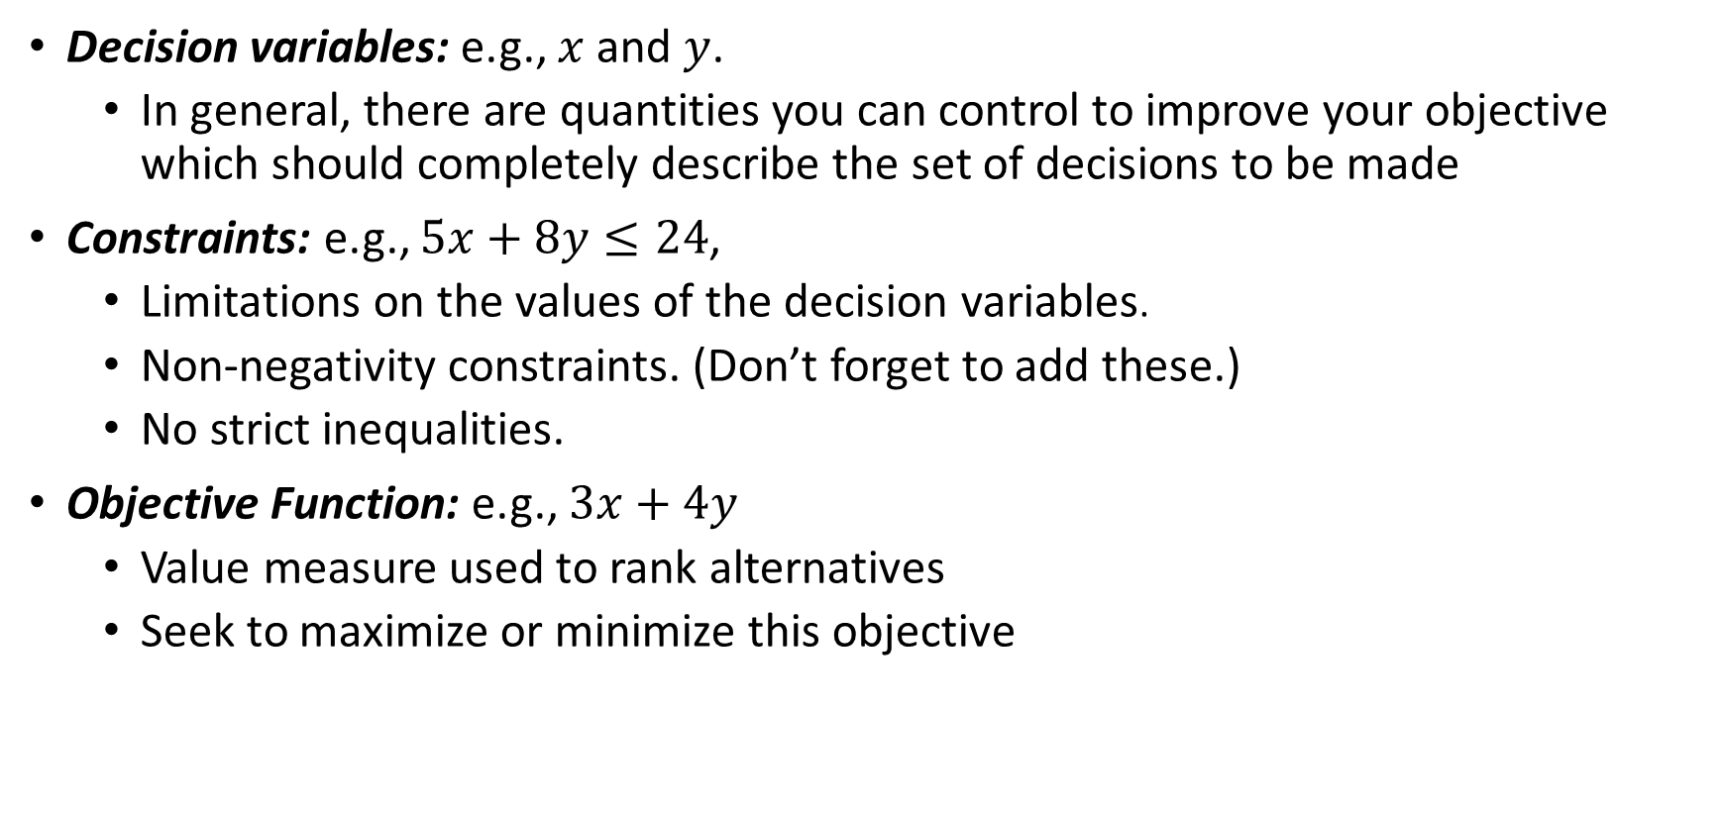
Terminology
Decision variables: e.g., $x$ and $y$.
  In general, there are quantities you can control to improve your objective which should completely describe the set of decisions to be made
Constraints: e.g., $5x+8y≤24$,
  Limitations on the values of the decision variables.
  Non-negativity constraints. (Don’t forget to add these.)
  No strict inequalities.
Objective Function: e.g., $3x+4y$
  Value measure used to rank alternatives
  Seek to maximize or minimize this objective

Slide 37
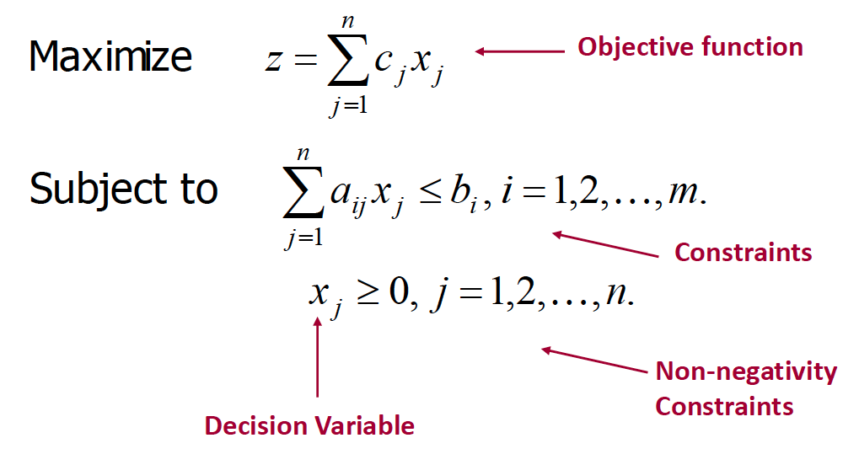
A Linear Program

Slide 38
LP Formulation Steps
Define decision variables, including their “units”
Express the objective function in terms of the decision variables. If unsuccessful, go to Step 1.
Express the constraints in the terms of the decision variables. If unsuccessful, go to Step 1.
LP formulation an iterative process.

Slide 39
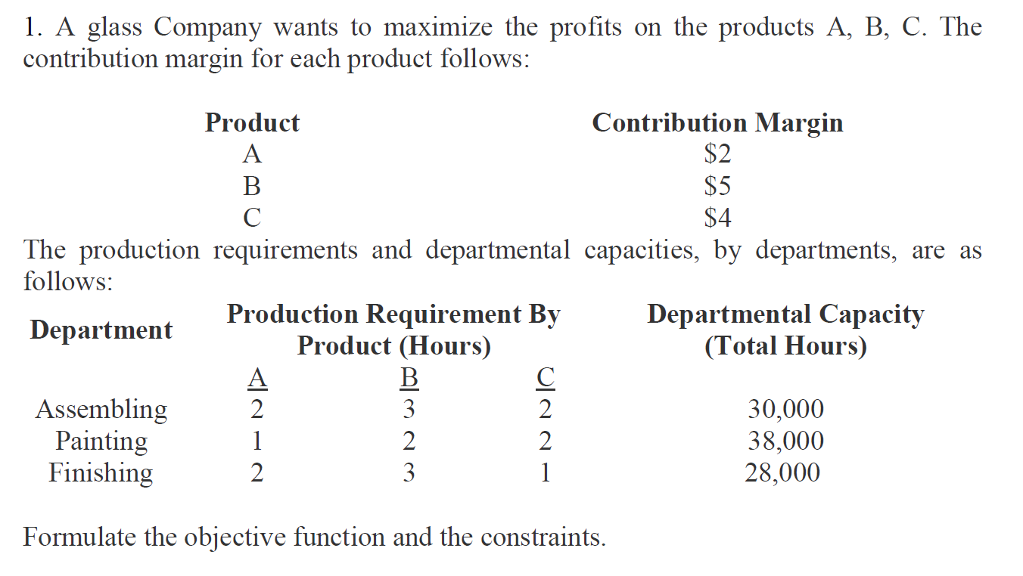
LP Modeling Examples 3

Slide 40
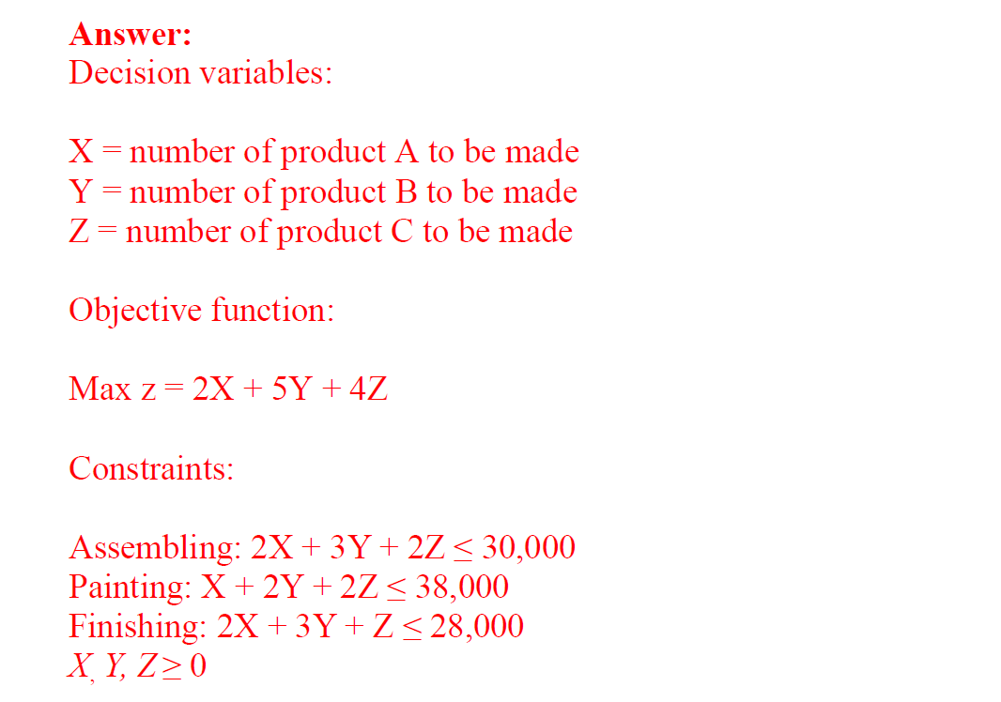
LP Modeling Examples 3

Slide 41
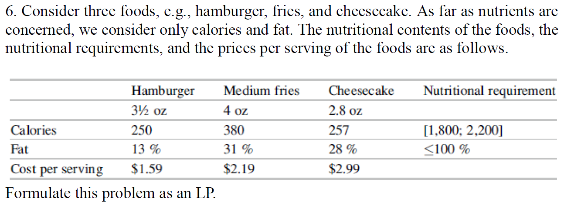
LP Modeling Examples 4
(Minimize cost and satisfy nutritional requirements)

Slide 42
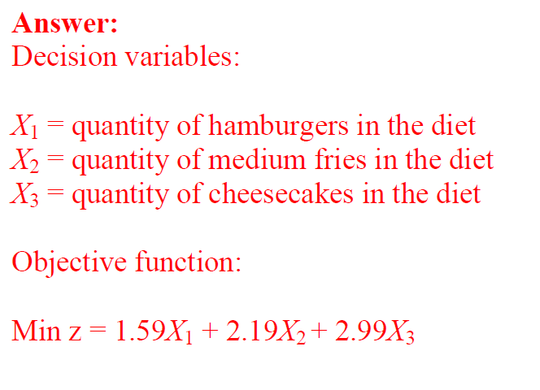
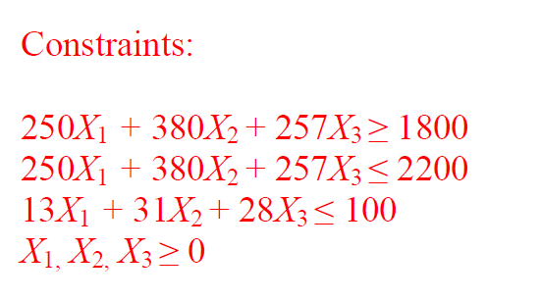
LP Modeling Examples 4

Slide 43
LP Modeling Examples: Oil Refinery
Sunco processes oil into aviation fuel and heating oil. It costs $40 to purchase each 1,000 barrels of oil, which is then distilled and yields 500 barrels of aviation fuel and 500 barrels of heating oil. Output from the distillation may be sold directly or processed in the catalytic cracker. If sold after distillation without further processing, aviation fuel sells for $60 per 1,000 barrels, and heating oil sells for $40 per 1,000 barrels. It takes 1 hour to process 1,000 barrels of aviation fuel in the catalytic cracker, and these 1,000 barrels can be sold for $130. It takes 45 minutes to process 1,000 barrels of heating oil in the cracker, and these 1,000 barrels can be sold for $90. Each day, at most 20,000 barrels of oil can be purchased, and 8 hours of cracker time are available. Formulate an LP to maximize Sunco’s profits. Clearly define decision variables, objective function and constraints.

Slide 44
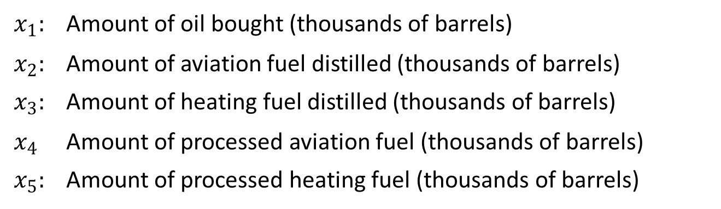
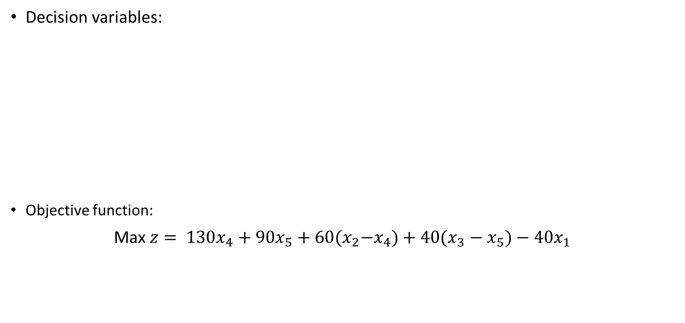
LP Modeling Examples: Oil Refinery
Decision variables:
Objective function:
Max $z= 130x_{4}+90x_{5}+60{(x}_{2}−x_{4})+40(x_{3}−x_{5})−40x_{1}$
$$x_{1}:$$ | Amount of oil bought (thousands of barrels)
$$x_{2}:$$ | Amount of aviation fuel distilled (thousands of barrels)
$$x_{3}:$$ | Amount of heating fuel distilled (thousands of barrels)
$$x_{4}$$ | Amount of processed aviation fuel (thousands of barrels)
$$x_{5}:$$ | Amount of processed heating fuel (thousands of barrels)

Slide 45
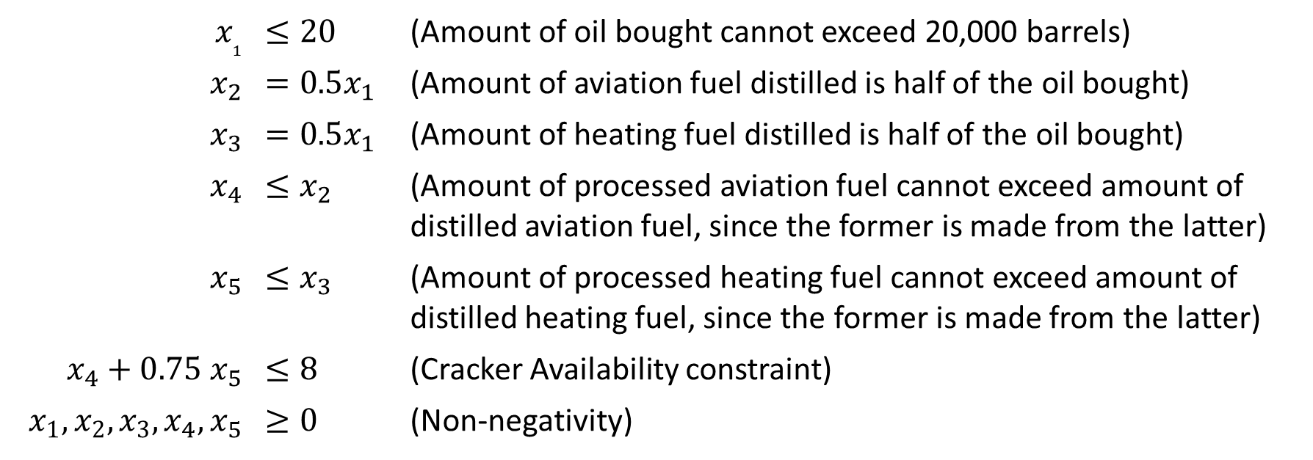
LP Modeling Examples: Oil Refinery
Constraints:
$$x_{1}$$ | $$≤20$$ | (Amount of oil bought cannot exceed 20,000 barrels)
$$x_{2}$$ | $$=0.5x_{1}$$ | (Amount of aviation fuel distilled is half of the oil bought)
$$x_{3}$$ | $$=0.5x_{1}$$ | (Amount of heating fuel distilled is half of the oil bought)
$$x_{4}$$ | $$≤x_{2}$$ | (Amount of processed aviation fuel cannot exceed amount of distilled aviation fuel, since the former is made from the latter)
$$x_{5}$$ | $≤x_{3}$ | (Amount of processed heating fuel cannot exceed amount of distilled heating fuel, since the former is made from the latter)
$$x_{4}+0.75 x_{5}$$ | $≤8$ | (Cracker Availability constraint)
$$x_{1},x_{2},x_{3},x_{4},x_{5}$$ | $$≥0$$ | (Non-negativity)

Slide 46
LP Modeling Examples: Currency Exchange
An international company has operations in USA, United Kingdom, China, Germany and Japan and they have daily varying needs and surpluses for cash in these countries currencies. Accordingly, the company needs to do large scale currency exchanges and cash transfers very frequently. The decision of which surplus currencies to exchange for which demanded currencies, is a frequently faced decision that needs a fast answer and in aggregate, considerably effects overall profitability.
On a specific day, Chinese operations have 8 Million Yuan and Japanese operations have 1280 million yen urgent cash need; while, USA operations have $2 million, British operations have £5 million and German operation have €3 million cash surplus.

Slide 47
LP Modeling Examples: Currency Exchange
Exchange rates faced by the company that morning between all currency pairs are as follows.
According to the above table, it is possible to buy £0.69980 with $1; while £1 buys $1.425, i.e., there is a natural commission and buy/sell loss between buying and selling prices (while $1 buys £0.69980, £0.69980 buys only 0.69980x1.425 = $0.99722). The levels of these commissions and price differentials, change from one currency pair to another.
The problem of which currency need to satisfy by which currency surpluses, and which currency transactions to undertake, to maximize total remaining assets (or equivalently minimize overall exchange commissions) can be modeled and solved through LP.
 | 1.Dollar | 2.Pound | 3.Yuan | 4.Euro | 5.Yen
1.Dollar | 1.00000 | 0.69980 | 8.07800 | 2.62700 | 224.700
2.Pound | 1.42500 | 1.00000 | 11.55000 | 3.75400 | 320.700
3.Yuan | 0.12340 | 0.08647 | 1.00000 | 0.32500 | 27.760
4.Euro | 0.37930 | 0.22620 | 3.07300 | 1.00000 | 85.510
5.Yen | 0.00443 | 0.00310 | 0.03586 | 0.01163 | 1.00000

Slide 48
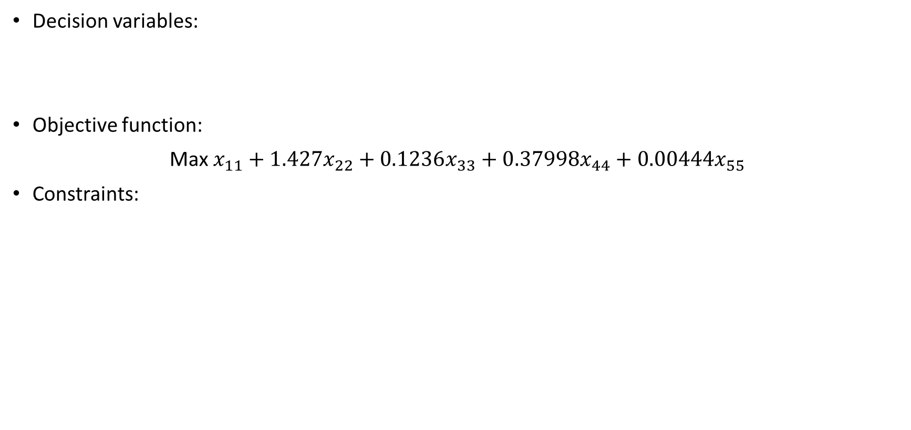
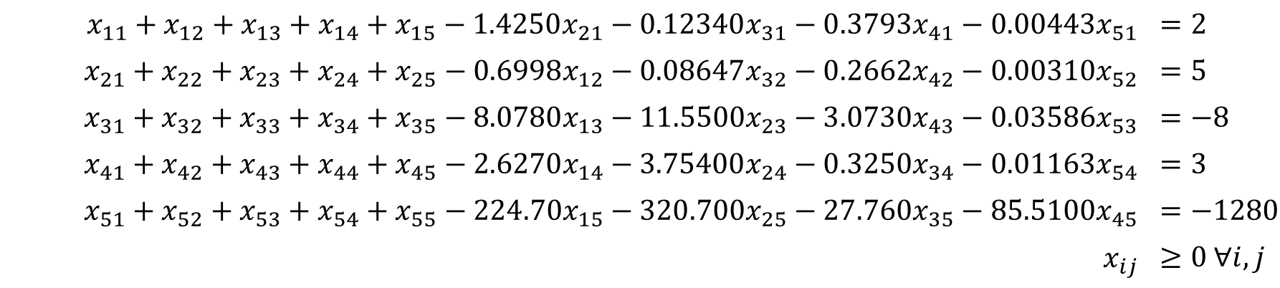
LP Modeling Examples: Currency Exchange
Decision variables:
Objective function:
Max $x_{11}+1.427x_{22}+0.1236x_{33}+0.37998x_{44}+0.00444x_{55}$
Constraints:
$x_{ij}$: | Amount to be sold from currency $i$, to buy currency $j$, where $i=1,…,5, j=1,…,5, i≠j$
$x_{ii}$: | Cash position in currency $i$ at the end of the day, $i=1,…,5$
$$x_{11}+x_{12}+x_{13}+x_{14}+x_{15}−1.4250x_{21}−0.12340x_{31}−0.3793x_{41}−0.00443x_{51}$$ | $$=2$$
$$x_{21}+x_{22}+x_{23}+x_{24}+x_{25}−0.6998x_{12}−0.08647x_{32}−0.2662x_{42}−0.00310x_{52}$$ | $$=5$$
$$x_{31}+x_{32}+x_{33}+x_{34}+x_{35}−8.0780x_{13}−11.5500x_{23}−3.0730x_{43}−0.03586x_{53}$$ | $$=−8$$
$$x_{41}+x_{42}+x_{43}+x_{44}+x_{45}−2.6270x_{14}−3.75400x_{24}−0.3250x_{34}−0.01163x_{54}$$ | $$=3$$
$$x_{51}+x_{52}+x_{53}+x_{54}+x_{55}−224.70x_{15}−320.700x_{25}−27.760x_{35}−85.5100x_{45}$$ | $$=−1280$$
$$x_{ij}$$ | $$≥0 ∀i,j$$

